Slide 1
A Real Time Application to Identify Alcoholics from ECG Signals
Akarsh N Kolekar (1PI13EC009) Guide: Dr. b Niranjana Krupa
Apoorv Vatsal (1PI13EC017)
Rakshith Vishwanatha (1PI13EC075)

Slide 2
STATUS QUO – Breathalyser Disadvantages
Contamination -- SiO2 sensor -- frequent recalibration
Breathalyzers medium for contagious diseases
Interfering components (like acetone) -- detected falsely
Infrared sensors are prone to error in environments – lighting, windy, polluted
To develop a prototype to read ECG signals, perform HRV analysis to extract features, and use these to classify the person under test as an alcoholic (person under the influence of alcohol) or otherwise.

Slide 3
SOLUTION
Implement a method that is less prone to environmental disturbances and corrosion
Electrode contacts are less prone to corrosion and contamination than breathalyser sensor
Implement a method that requires no recalibration
Well trained machine learning algorithms will output consistent results over time and will not require recalibration once calibrated
Less scope for disease propagation
Contact through hand and not mouth

Slide 4
OVERALL FLOW
Study of ECG/HRV, artifacts, Existing circuit
Methods to improve circuit, KubiosHRV
Interface sensor to R-pi with some improvements
Begin implementation of Feature Extraction (FE)
Proceed with FE, and begin with training Classifier

Slide 5
OVERALL FLOW
Finish FE, Proceed training Classifiers
Begin with R-pi coding (real time data capture - RTDC)
Finish training Classifiers, Proceed with RTDC and start Classifiers on R-pi
Tie up loose ends, Begin integration of modules
Package into product

Slide 6
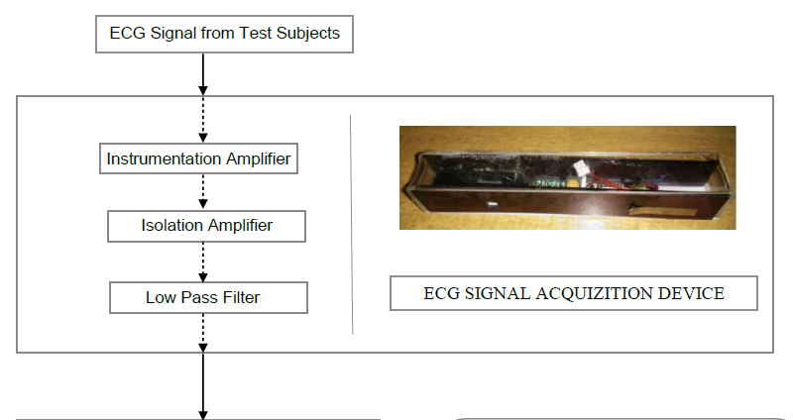
BLOCK REPRESENTATION

Slide 7
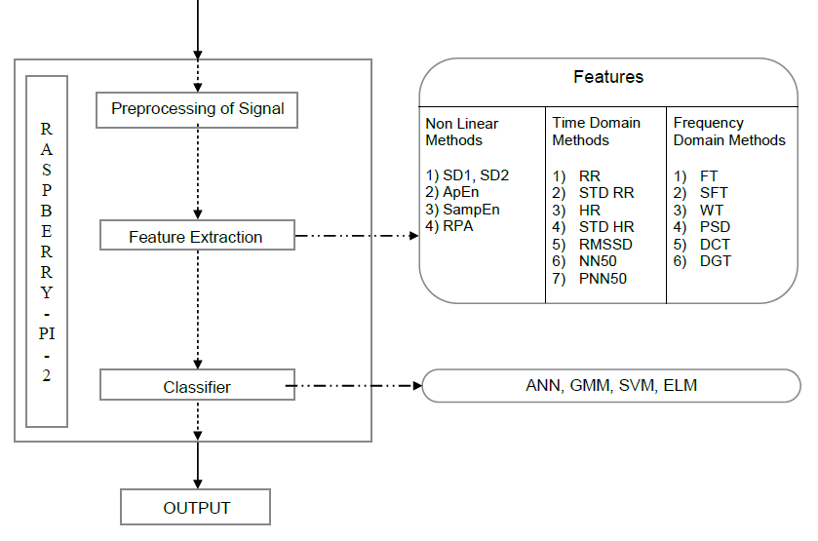
BLOCK REPRESENTATION

Slide 8
SOFTWARE & HARDWARE
SOFTWARE:
MATLAB – to train system and obtain weights
Python Libraries – implementation of PC on Raspberry Pi
Multisim – Sensor modifications and tuning
HARDWARE:
Raspberry Pi – processing board to implement the classifier
ECG Sensor – to read real time ECG signal

Slide 9
EXPECTED OUPUT
End to end working model of the system
Real time ECG graphs will be obtained, features from the graph will be extracted, and classification of test subject as alcoholic or normative will be performed

Slide 10
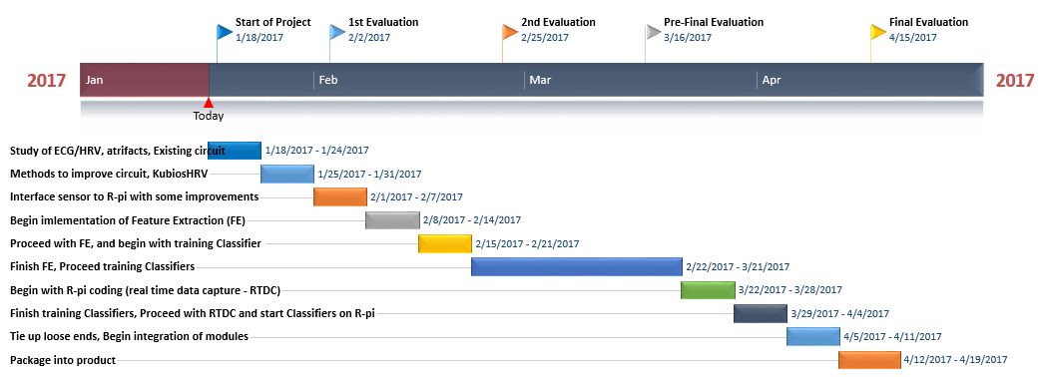
TIMELINE

Slide 11
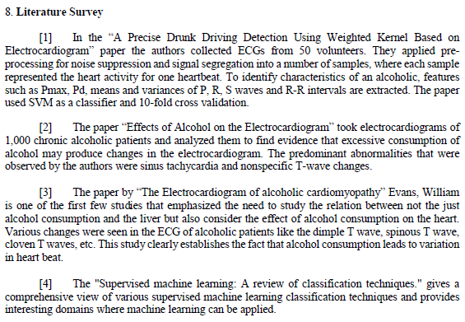
LITERATURE SURVEY

Slide 12
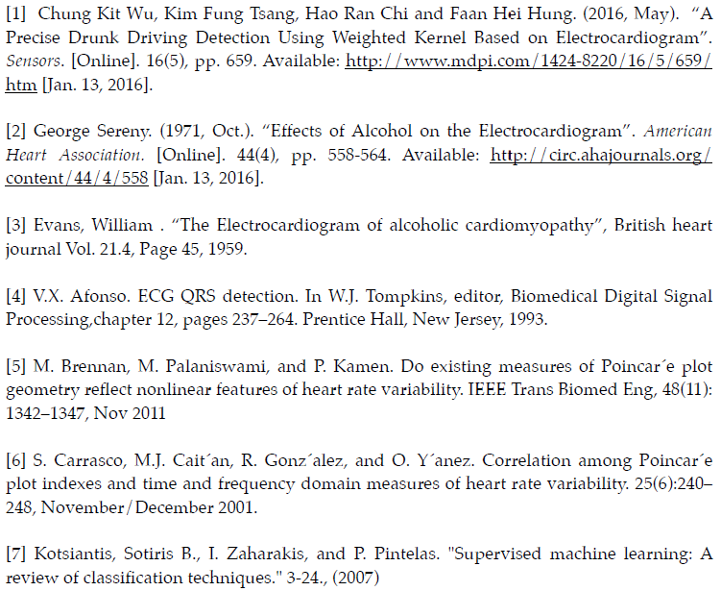
REFERENCES

